Slide 1
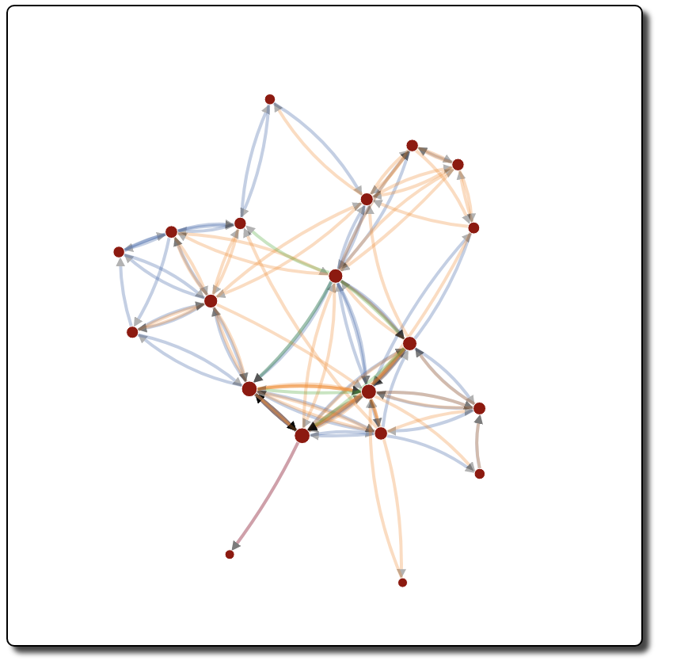
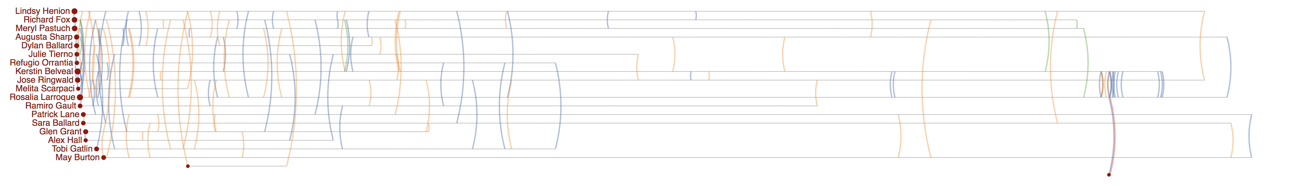
Rosalia Larroque
Rosalia Larroque
Jenice Savaria
Jenice Savaria

Slide 2
Rosalia Larroque
Rosalia Larroque
Jenice Savaria
Jenice Savaria

Slide 3
Rosalia Larroque
Rosalia Larroque
Jenice Savaria
Jenice Savaria

Slide 4
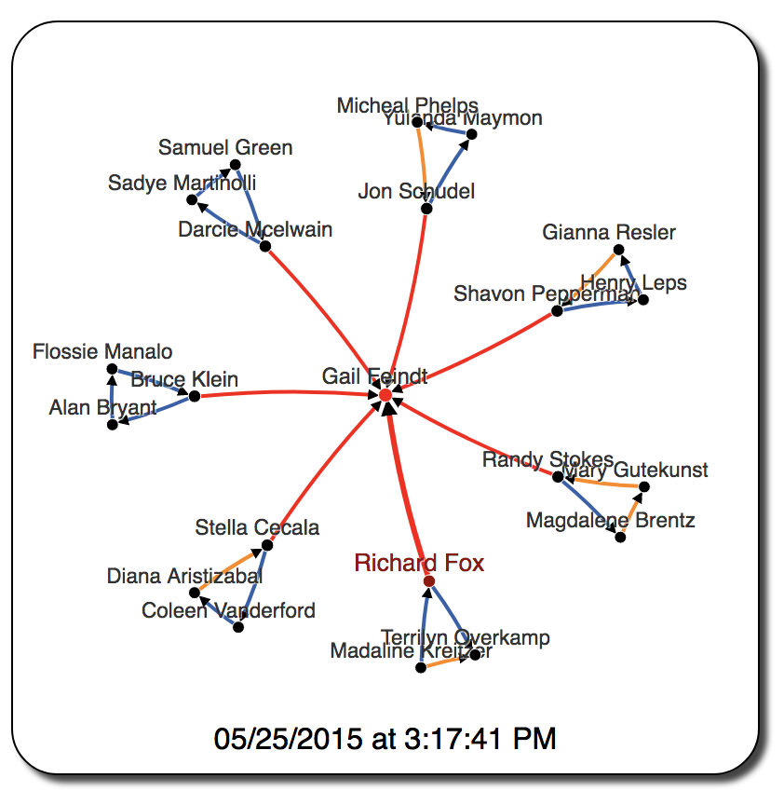
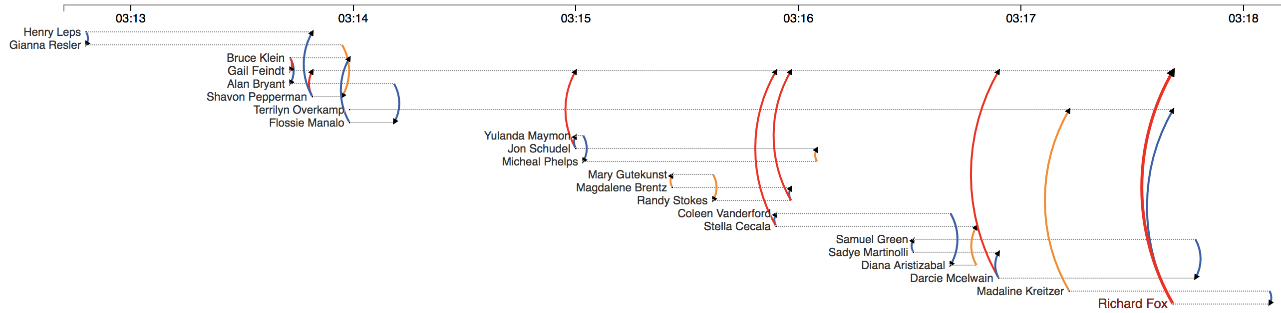

Slide 5
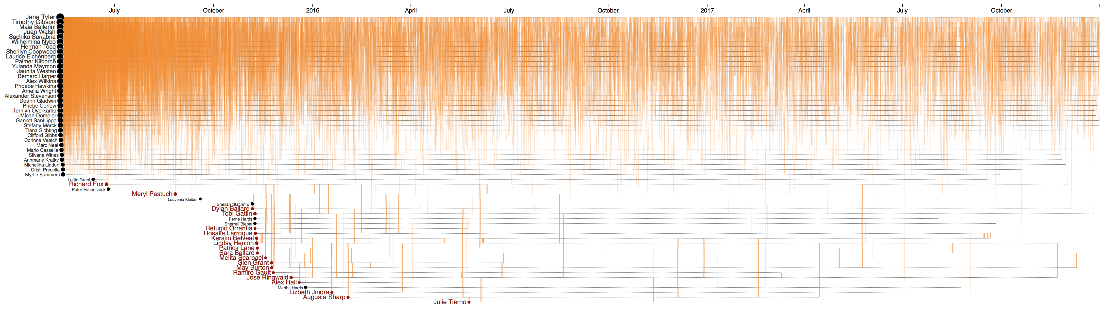
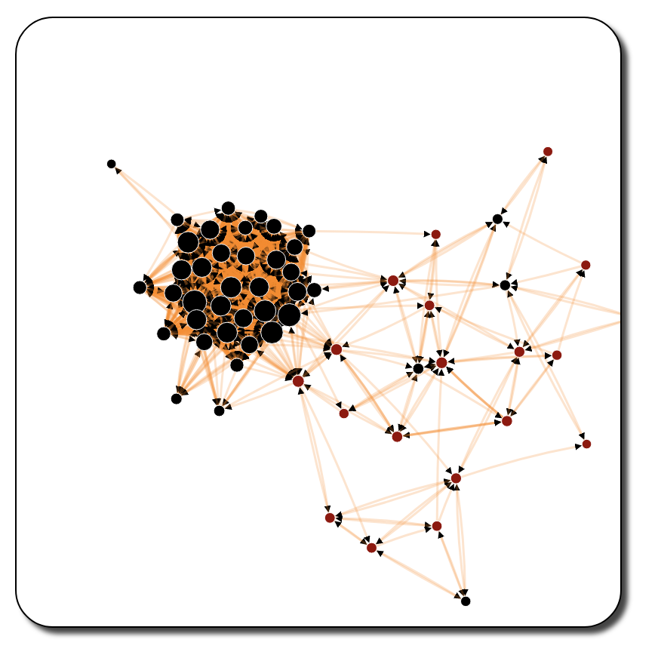
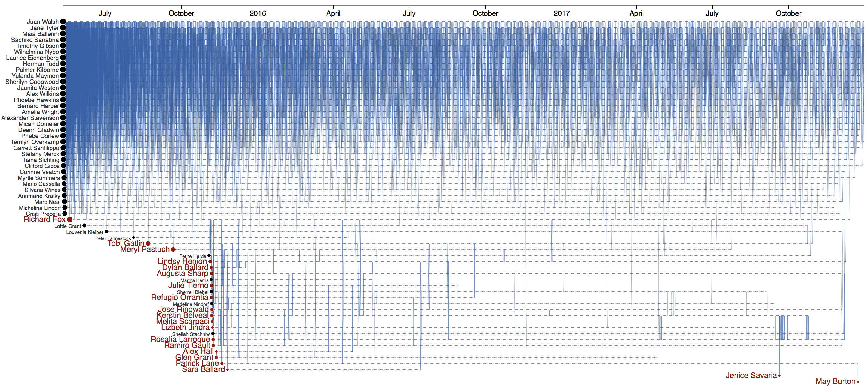
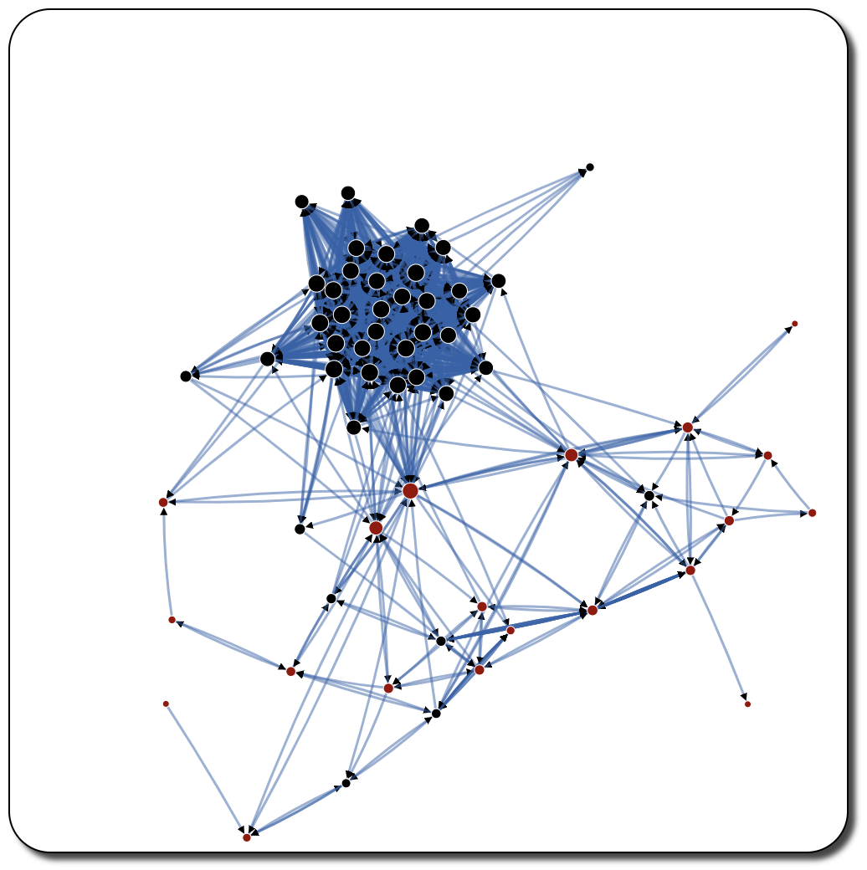

Slide 7
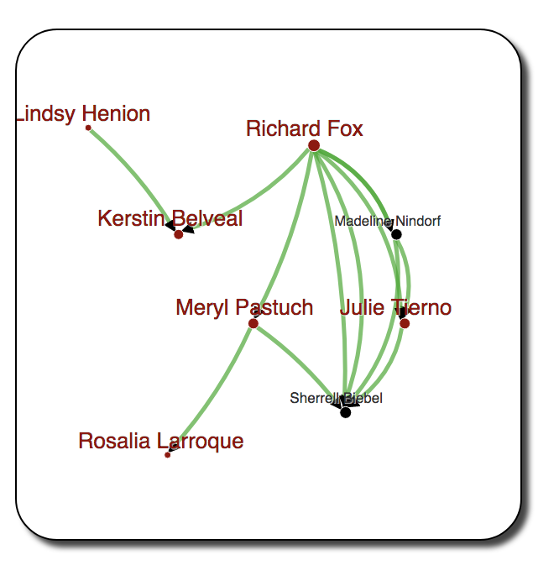
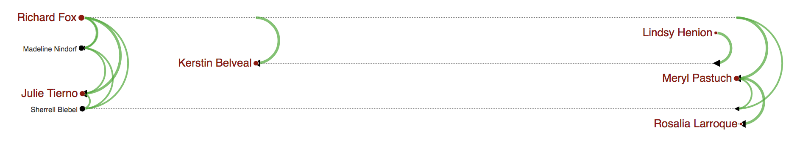
(a)
(b)
Gail Feindt

Slide 8
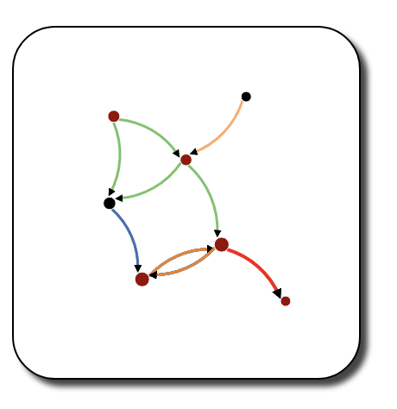
Richard Fox
Peter Fahnestock
Meryl Pastuch
Sherrell Biebel
Rosalia Larroque
Kerstin Belvea
Jenice Savaria
Jenice Savaria
(b)
(a)
Gail Feindt

Slide 9
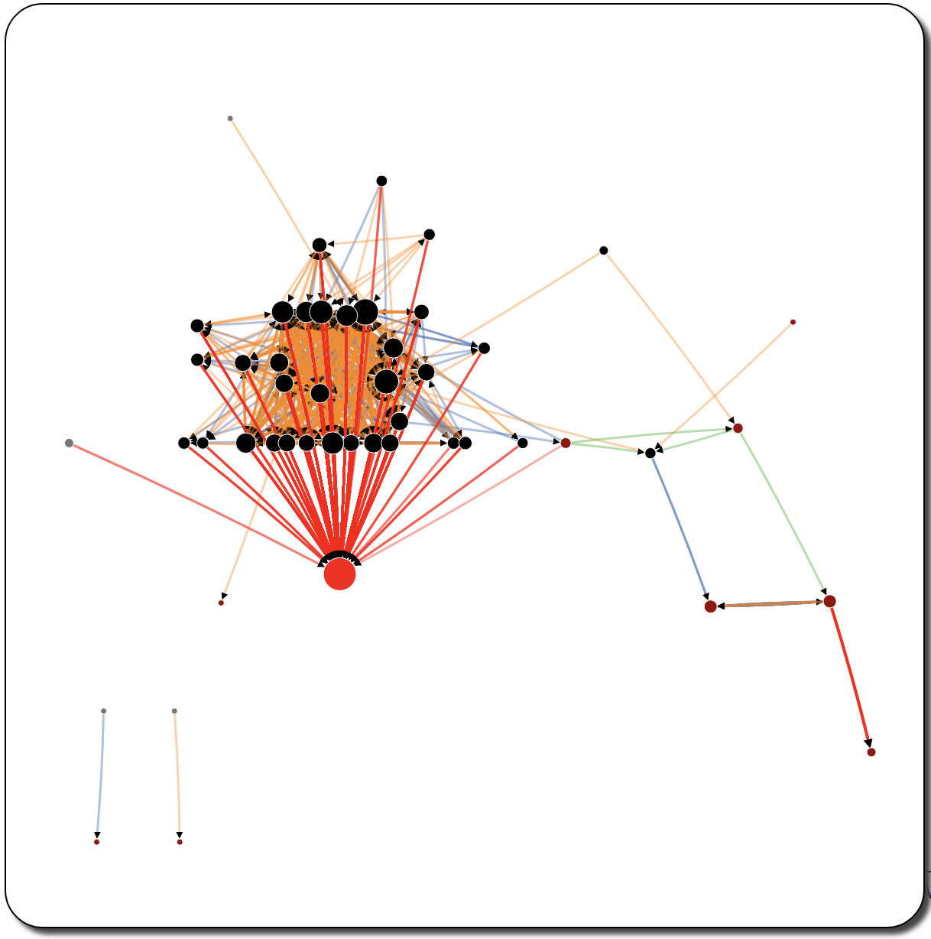
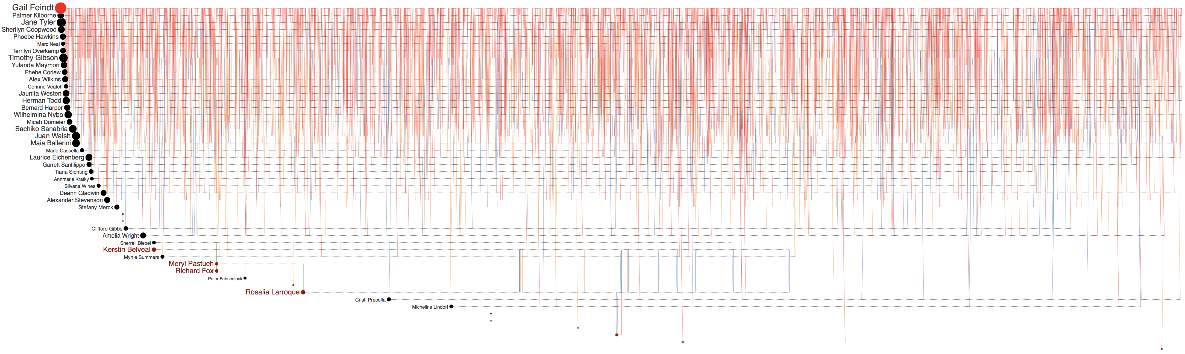
Peter Fahnestock
Meryl Pastuch
Richard Fox
Sherrell Biebel
Kerstin Belvea
Rosalia Larroque
Gail Feindt
Jenice Savaria
Jenice Savaria
Jenice Savaria

Slide 10
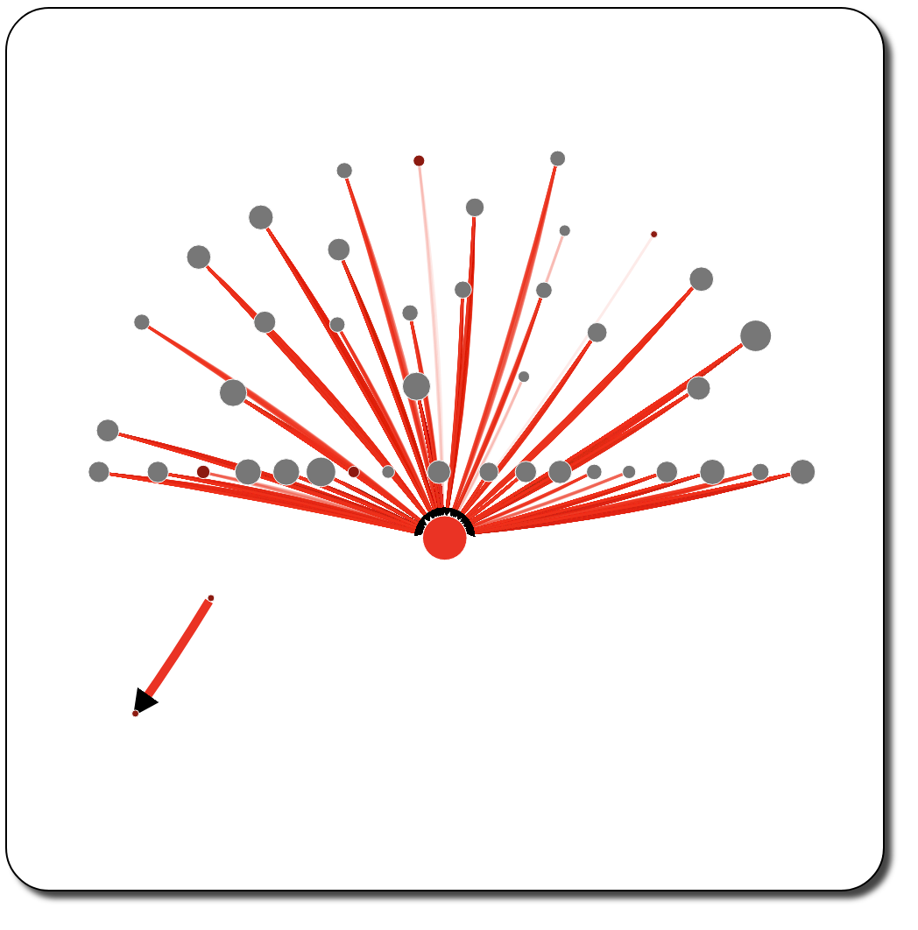
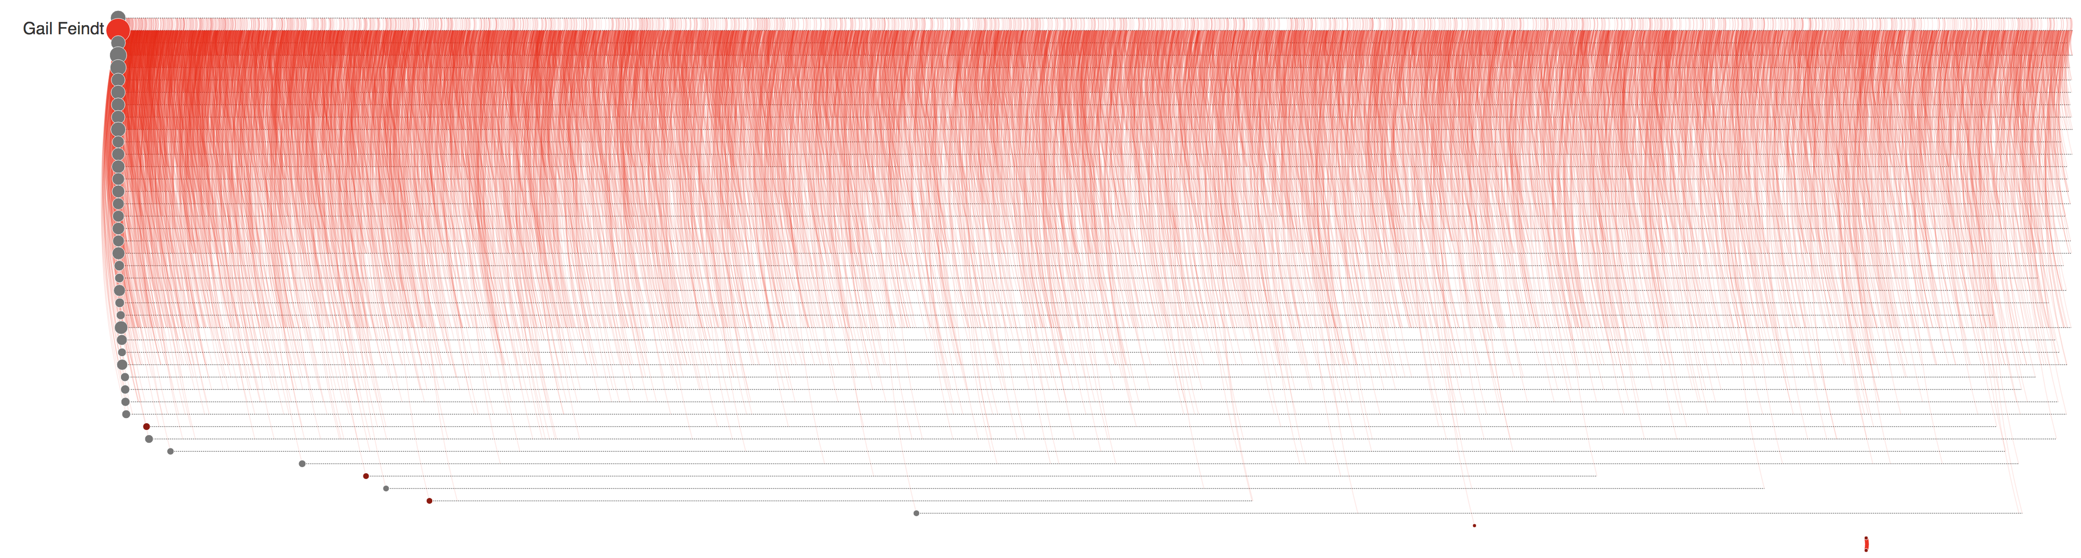


Rosalia Larroque
Jenice Savaria
(a)
(b)
Rosalia Larroque
Jenice Savaria

Slide 11
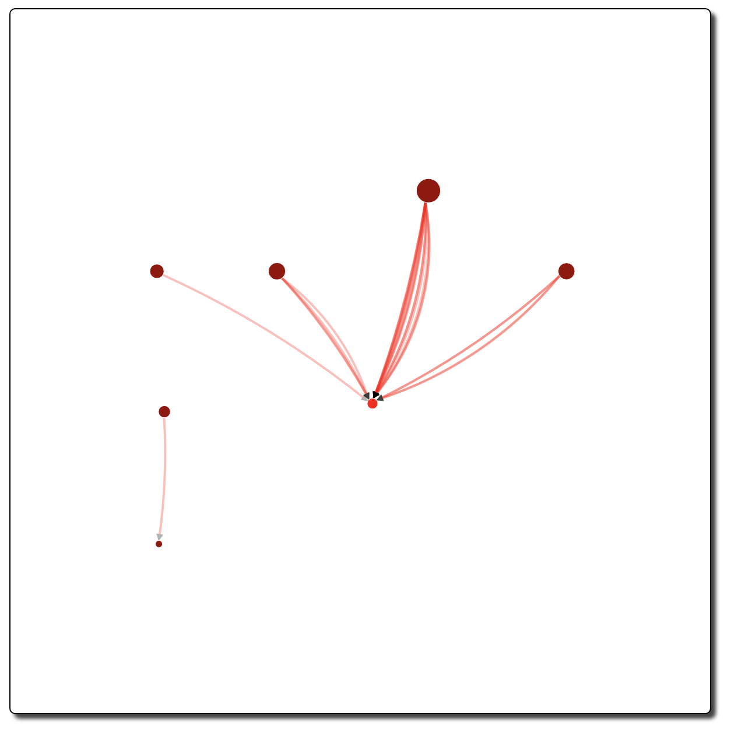
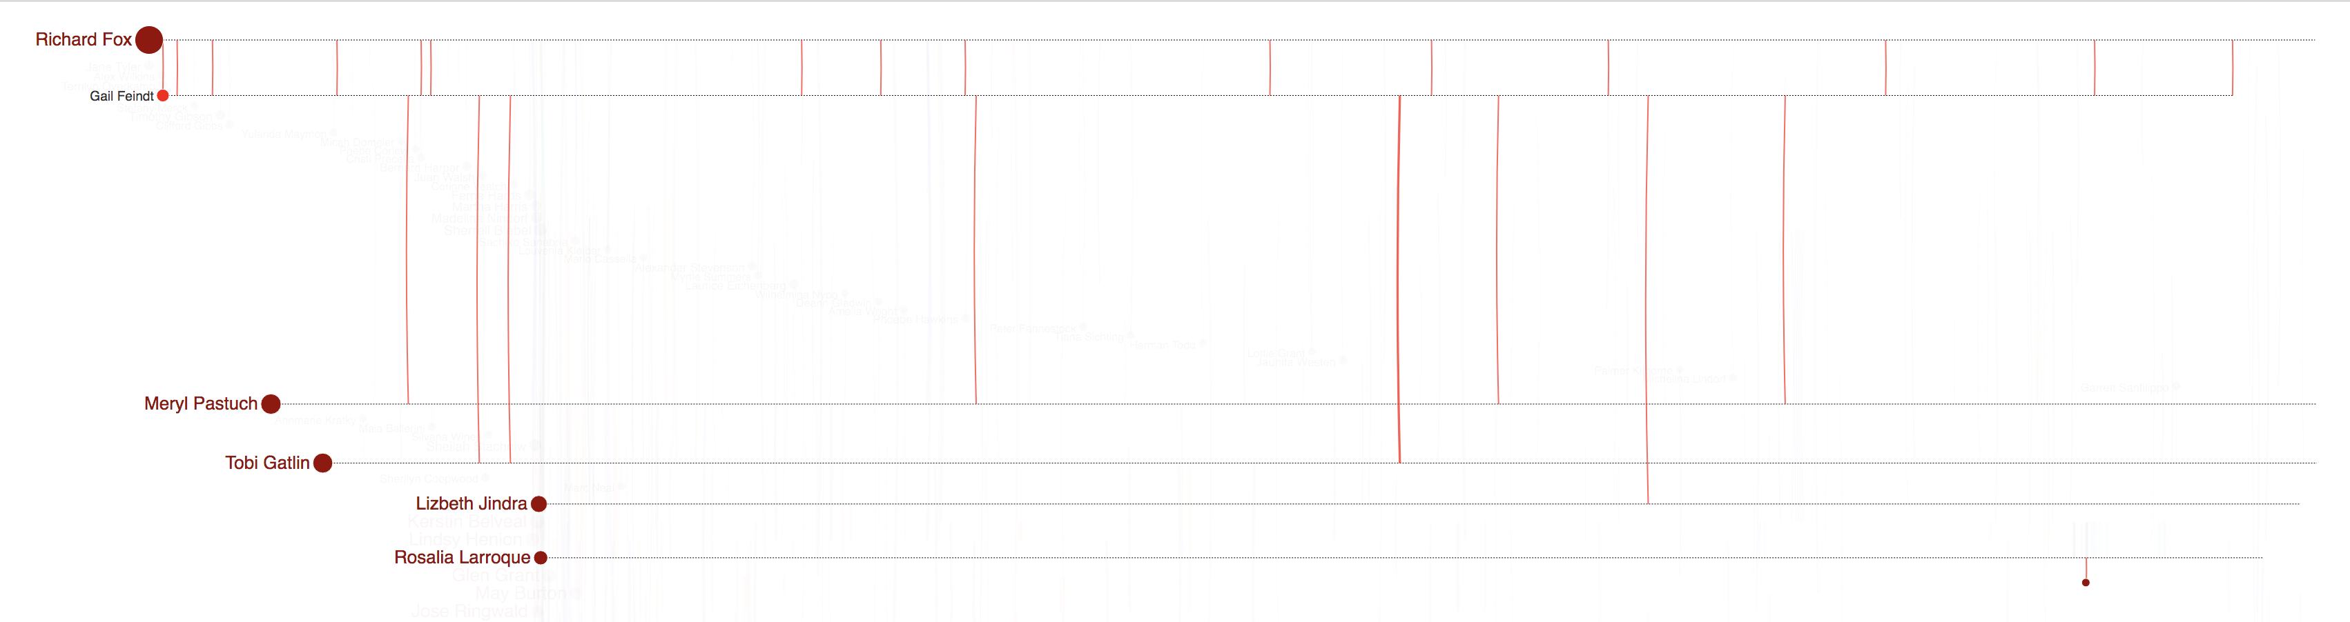
(a)
(b)

Slide 12
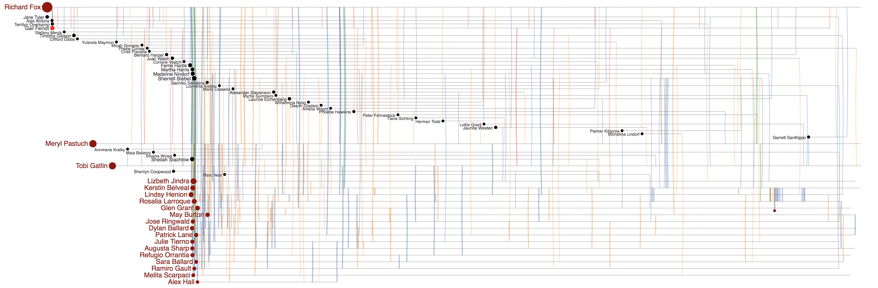
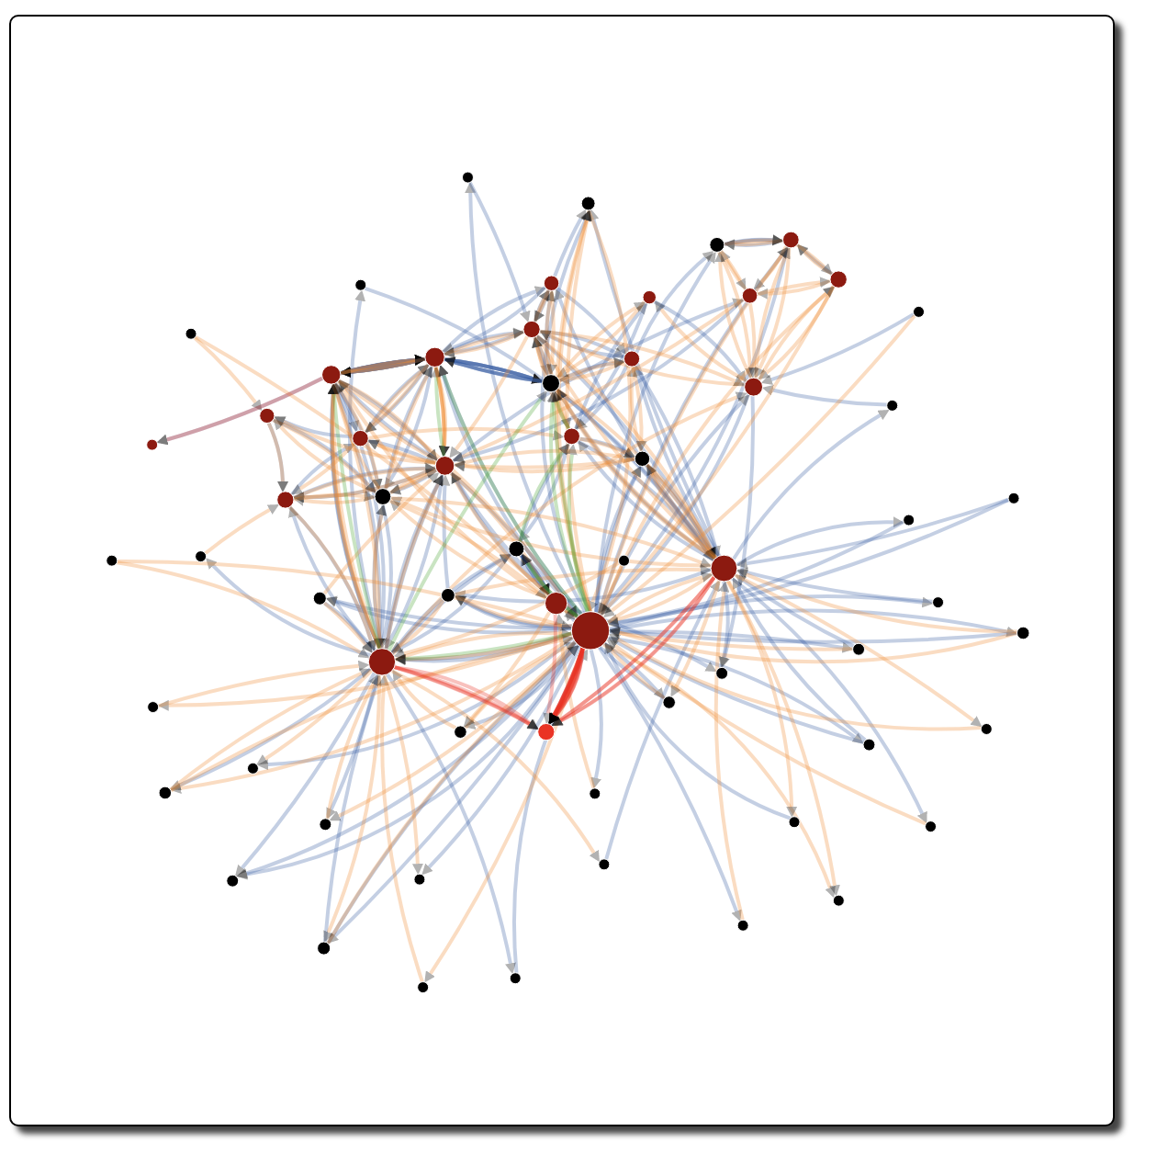
(a)
(b)

Slide 13
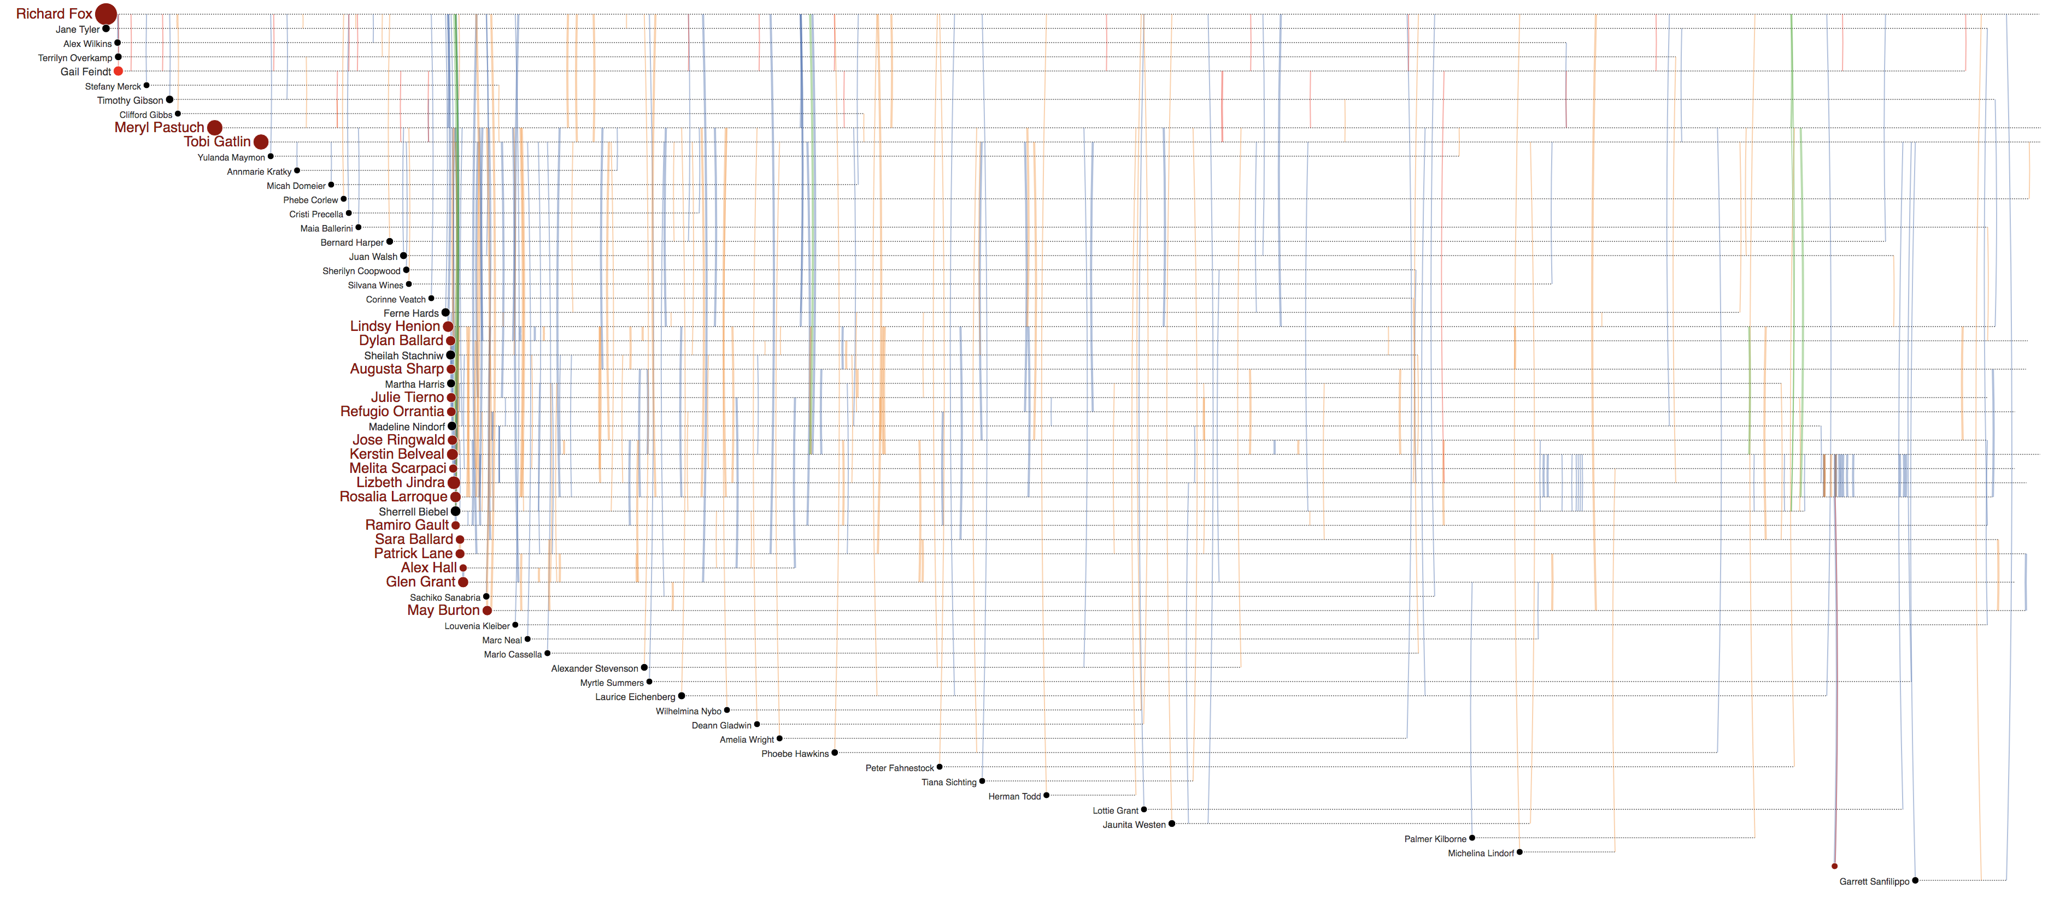
Jenice Savaria
Gail Feindt
(b)
Jenice Savaria
(a)
Jenice Savaria
(c)

Slide 14
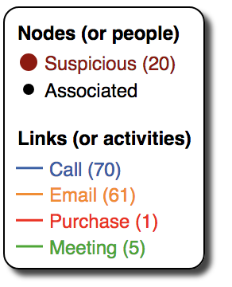
Rosalia Larroque
Rosalia Larroque
Jenice Savaria
(b)
Jenice Savaria
(a)

